Slide 1
PythonDayTen -I/O
PoHanWu
20190211

Slide 2
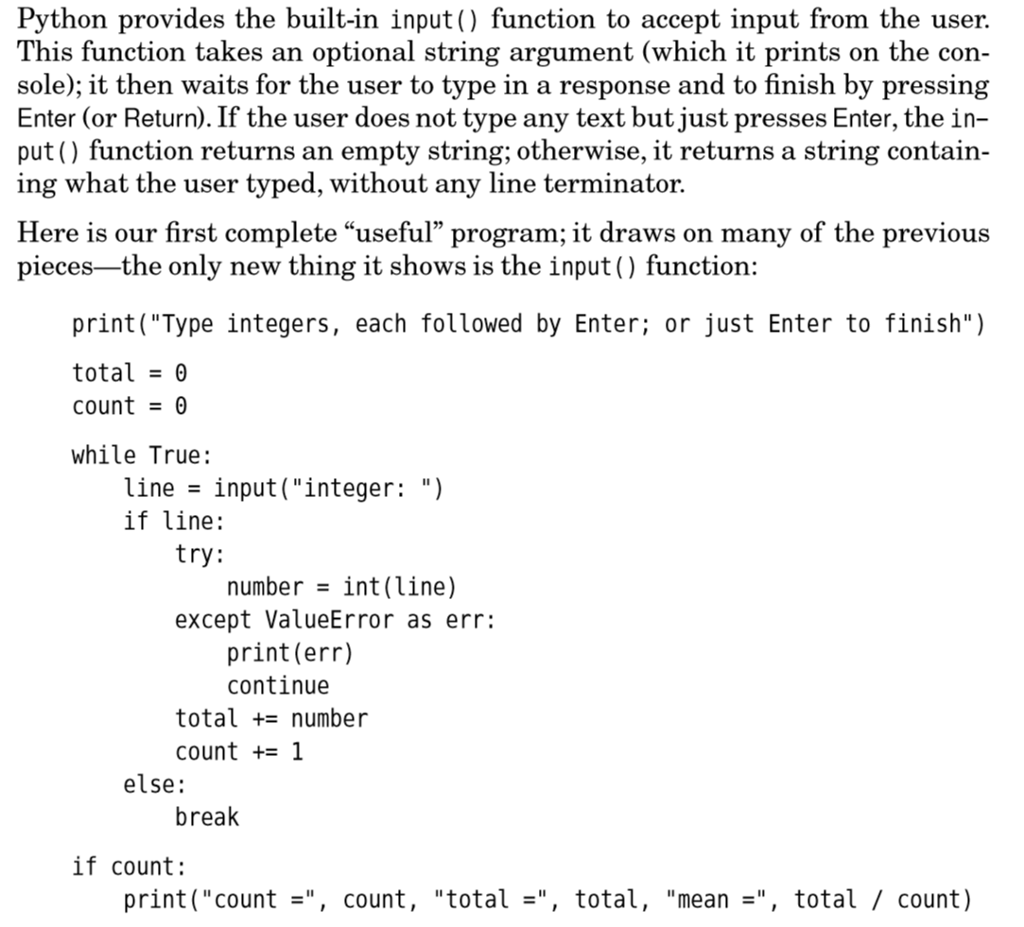
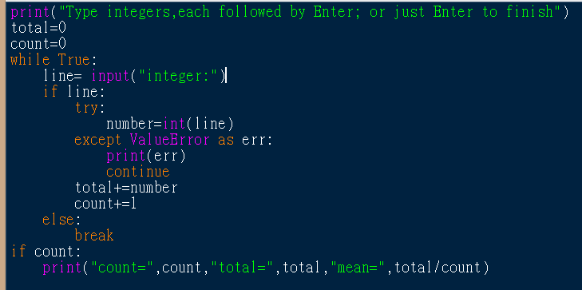

Slide 3
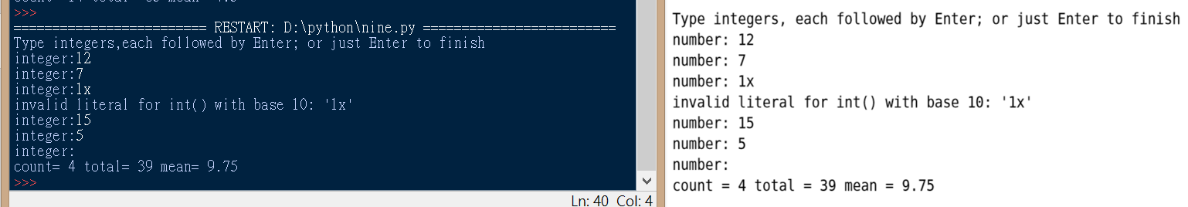

Slide 4

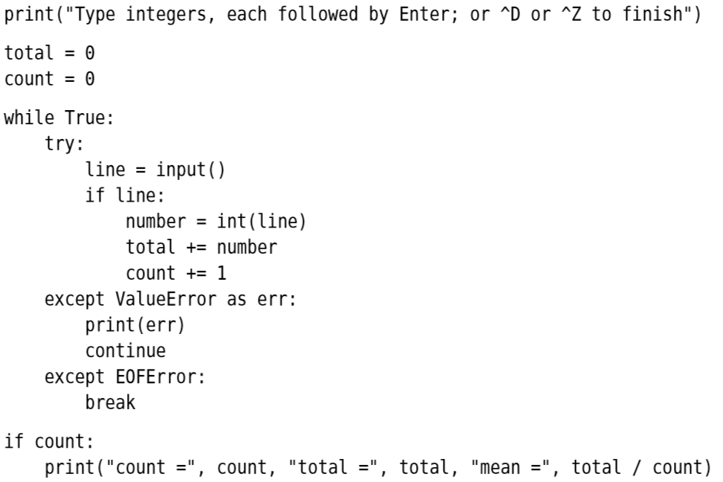

Slide 5
sum2.py < data\sum2.dat
Facing windows environment problem

